Slide 1
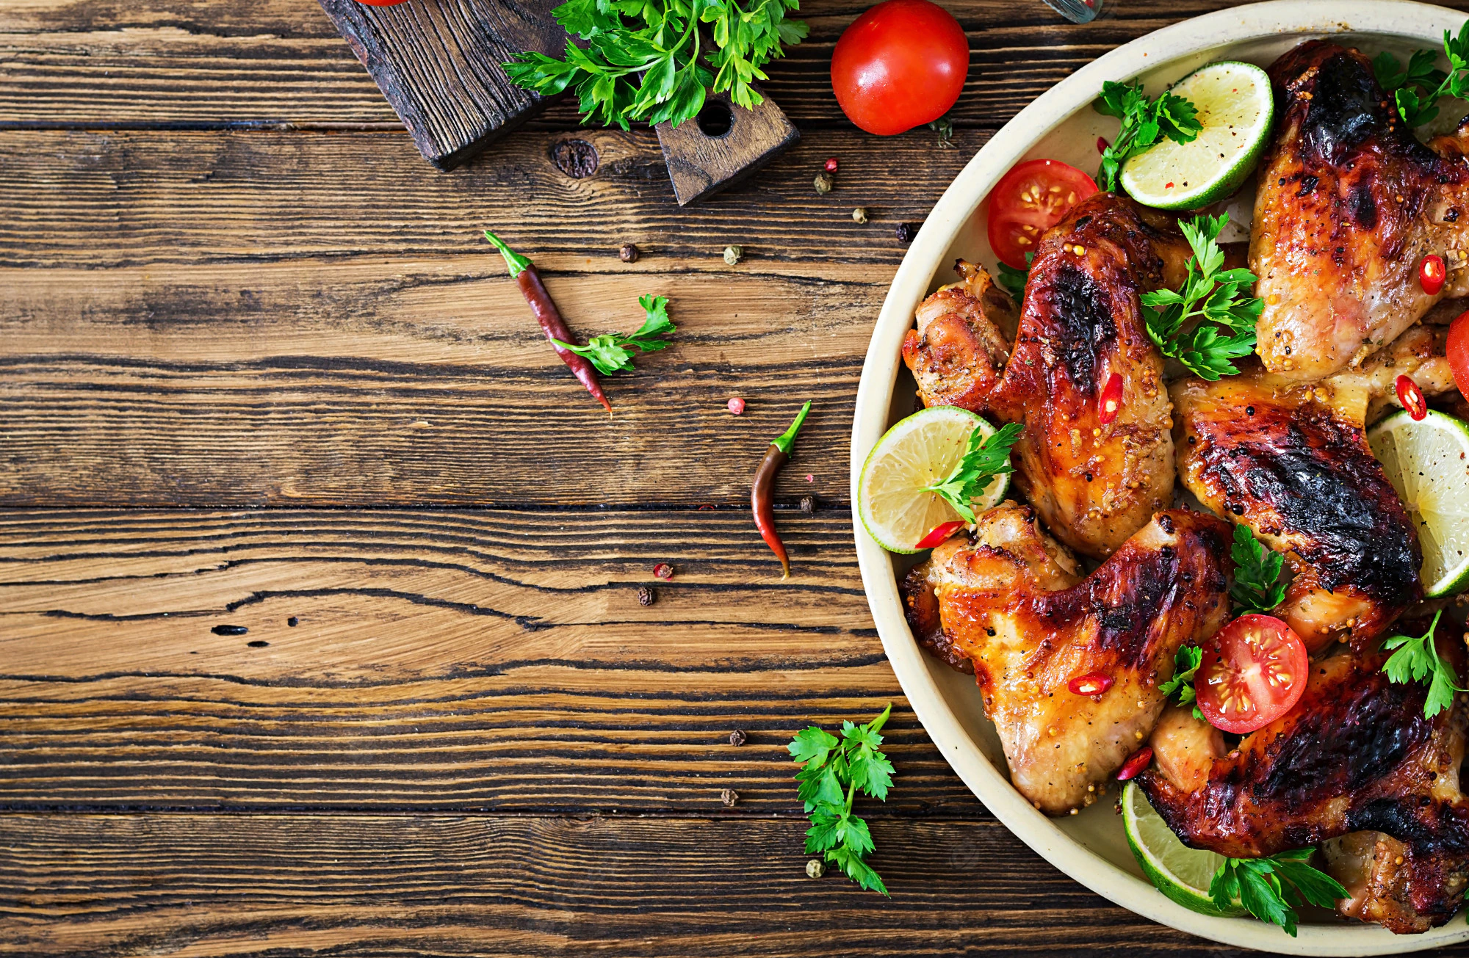

FOOD DELIVERY
01

Slide 2
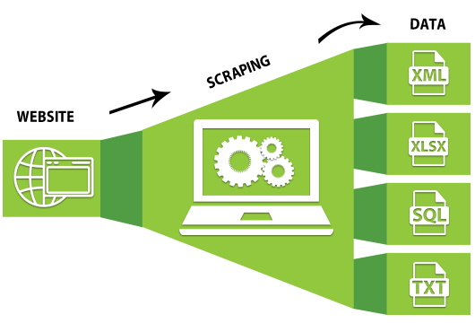
PHASES OF THIS PROJECT
Web Scrapping
CSV & Data Cleaning
Tableau Dashboard
Recommendation Model
HTML Webpage

Slide 3
WEB SCRAPPING
Selenium is a Python library and tool used for automating web browsers to do a number of tasks. One of such is web-scraping to extract useful data and information that may be otherwise unavailable.

Slide 4
Csv & Data cleaning
Cleaned the dataset using python that has been accumulated through Web-Scraping.
Conversion of raw dataset into a DataFrame.
Finally made a csv file for further analysis.

Slide 5

DASHBOARD - Tableau
For the key insights that we have received for our analysis
Used different charts to perform better visualisations
Merged with KPI’s to get a full picture of the analysis and finally made a dashboard

Slide 6
RECOMMENDATION MODEL
AIM:
Build a recommendation model for someone who wants to open a restaurant in Bangalore
Outcome:
With the help of Machine Learning we build a model that can predict the price and Location for opening a new restaurant

Slide 7
HTML WEBPAGE
1
2
Use a basic HTML coding for executing the frontend part through which the person can enter the details and based on that can get a recommended location and price for their restaurant
Used some python flask to develop a relationship between our model and the web page

Slide 8
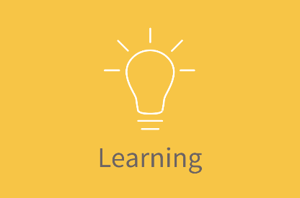
Learned to make html page How to make ML Model Time Management Googling Team Work Tableau Dashboard

Slide 9
CHALLENGES FACED
Difficulty in website scrapping.
Python Flask was completely unknown and new to learn
HTML was also a very new thing that we faced difficulty at.
All the terms used for the project are really tough but good to learn for us.

Slide 10
Thank you!
Write a closing statement or call-to-action here.

